Slide 1
Shotgun Sequencing: Problemi di Assemblaggio

Slide 2
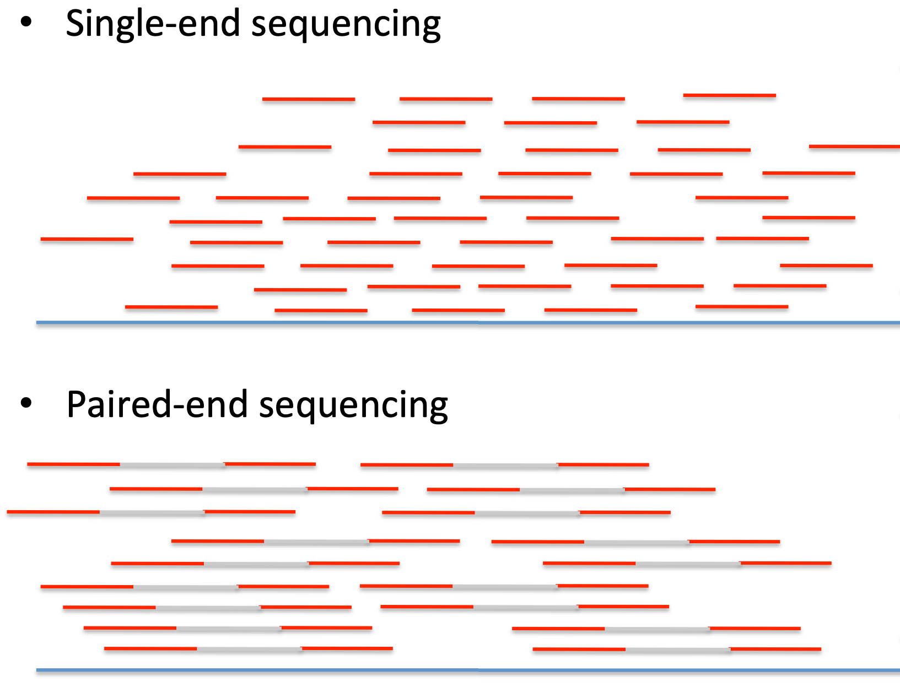

Slide 3
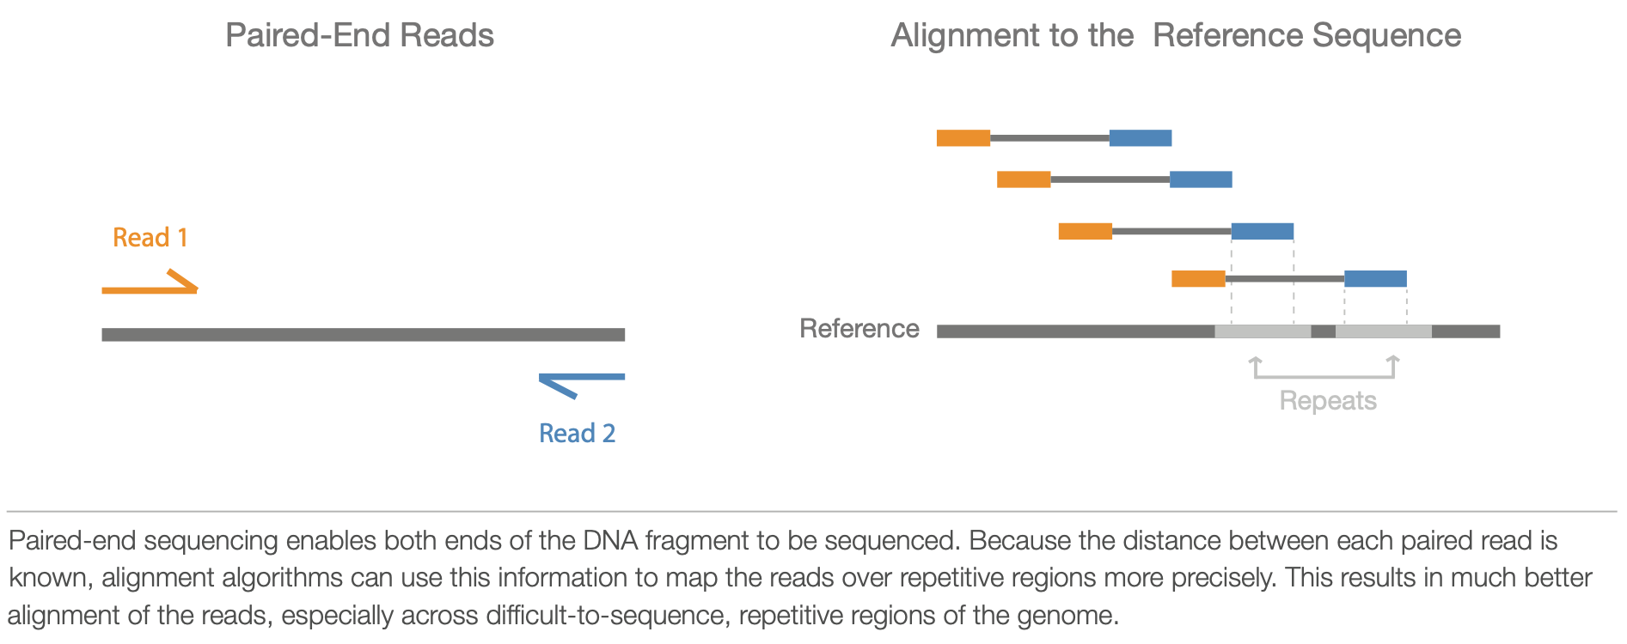
Paired-End Sequencing

Slide 4
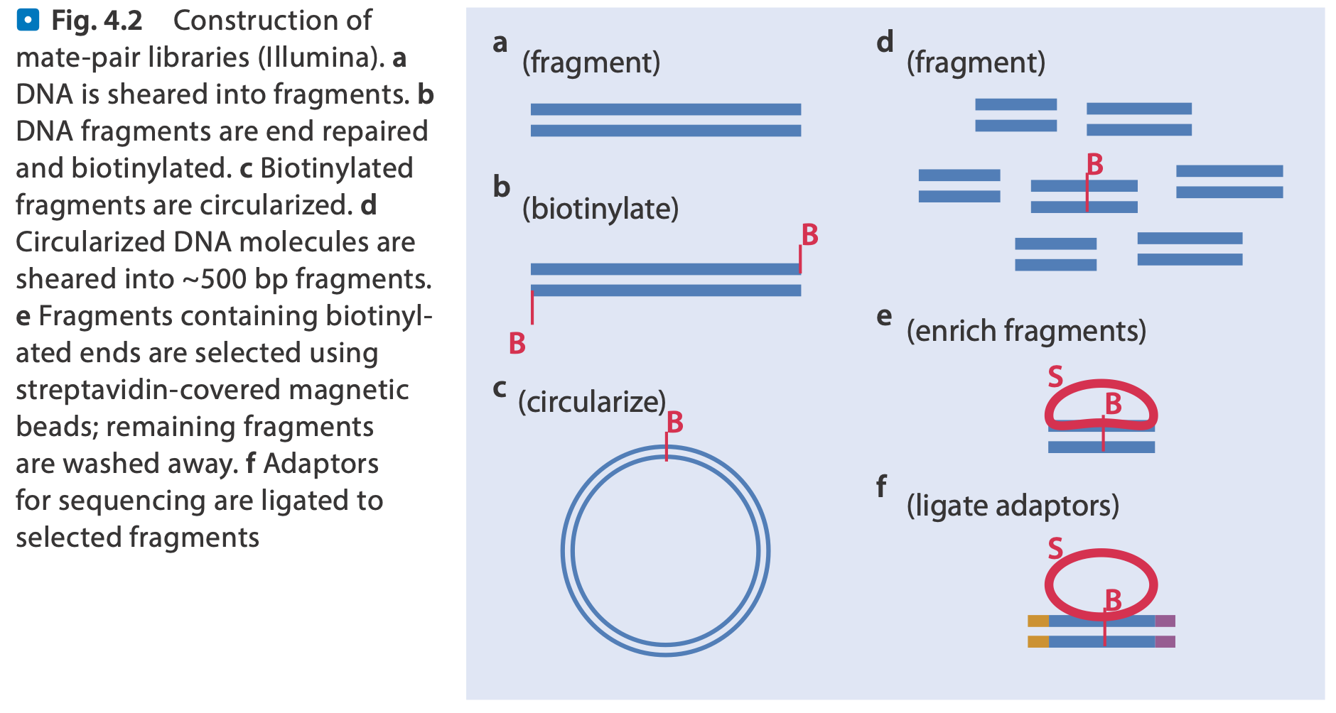
Mate-Pair Sequencing

Slide 5
Mate-Pair Sequencing

Slide 6
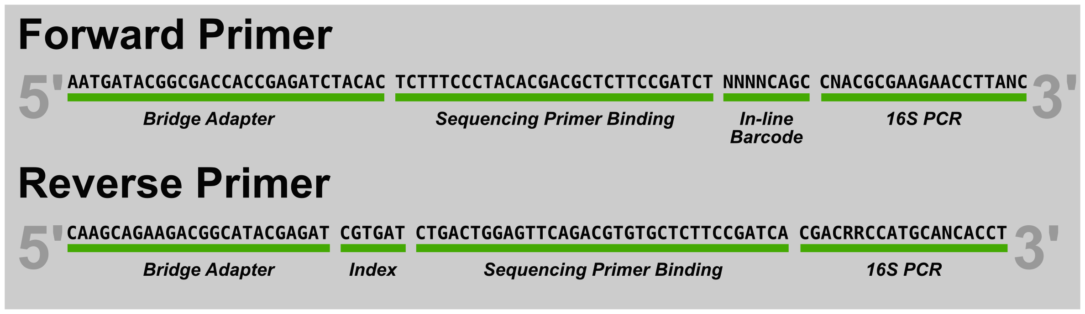
Multiplexing

Slide 7
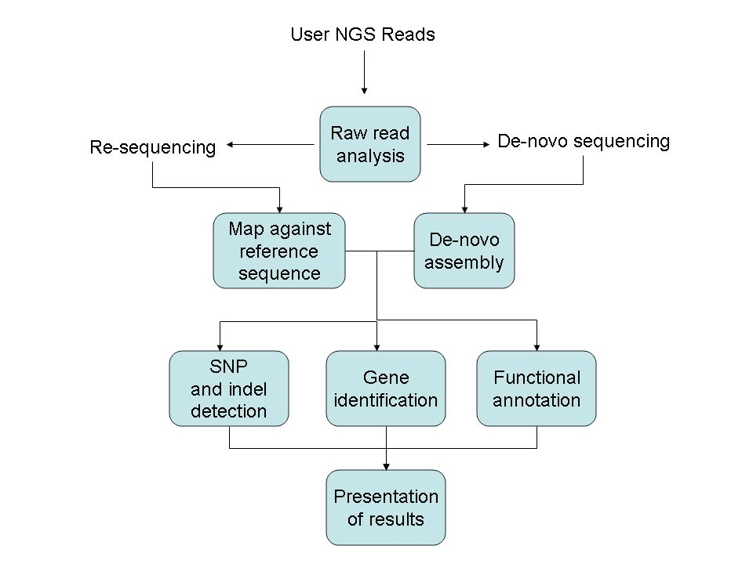
MPS Workflow

